Slide 1




Java Frameworks Spring
Course Overview
Java Frameworks Spring
SoftUni Team
Technical Trainers
Software University
http://softuni.bg

Slide 2



Table of Contents
Course Objectives
Course Program
Trainers Team
Exams and Evaluation
Learning Resources

Slide 3
Have a Question?
sli.do #JavaWeb

Slide 4


Java Frameworks Spring
Course Objectives & Program

Slide 5
Course Objectives
The Java Frameworks Spring course provides
Fundamental knowledge over MVC Architecture
Essentials of Thymeleaf Engine
Fundamental knowledge over what is Spring Security
Fundamental knowledge over the REST Services
Fundamental knowledge over the Web Unit Testing

Slide 6
Course Topics
Spring Boot Introduction
Spring Essentials
Spring Boot MVC - Thymeleaf Engine
Spring Boot MVC - Filters
Spring Boot MVC - Spring Security
Spring Boot MVC - The Right Way: Architecture
Spring Web API - Introduction
Spring Web API - REST Services
Spring Project Configuration
Spring - Unit Testing
Spring Cookbook

Slide 7
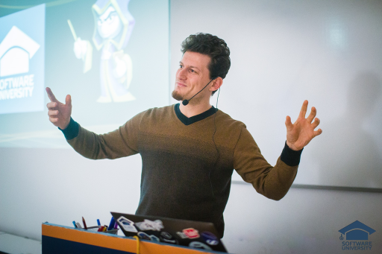
The Trainers Team

Slide 8

Trainers Team
Simeon Sheytanov
Technical Trainer @ Software University
Top performing student from the Software University
Programming experience with C#, Java, C++, Python, JavaScript, PHP, VB, Assembler and other programming languages
Interested in game development

Slide 9
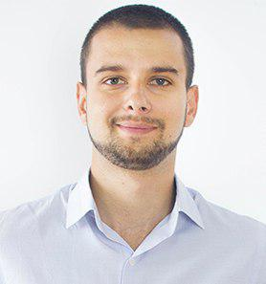
Trainers Team
Teodor Dimitrov
Technical Trainer @ Software University
Top performing student from the Software University
4 years of experience with SQL Server and Oracle
Background in telecommunication field

Slide 10


Scoring System for the Course
Mandatory:
Final project – 100%
Bonuses:
Presence in class – 5% bonus
Forum activity – bonus up to 5%

Slide 11
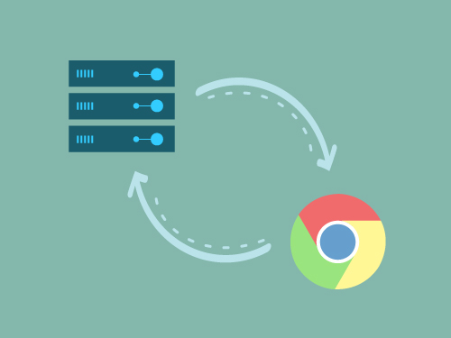
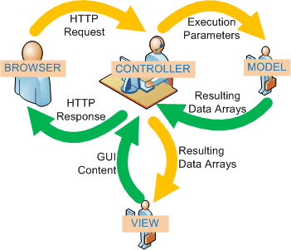
The Final Project
Create a web application using Spring Boot

Slide 12










Resources
What We Need Additionally?

Slide 13



Java Course Web Site, Forum and FB Group
Official web site:
Official discussion forum:
Official Facebook groups:
https://softuni.bg/trainings/1538/java-mvc-frameworks-spring-march-2017
https://softuni.bg/forum/categories/73/java-web-development-basics
https://www.facebook.com/groups/javaweb2017/

Slide 14

The Programming Basics Slides and Videos
All lecture slides, videos, homework assignments, projects and other resources are open content, available for free
Visit the course web site to access the course resources

Slide 15


Java Recommended Software
Software needed for this course:
IntelliJ Idea Ultimate - https://www.jetbrains.com/idea/
MySQL - https://www.apachefriends.org/index.html

Slide 16








Web Development Basics – Course Overview
https://softuni.bg/courses/

Slide 17
License
This course (slides, examples, demos, videos, homework, etc.) is licensed under the "Creative Commons Attribution-NonCommercial-ShareAlike 4.0 International" license

Slide 18





Free Trainings @ Software University
Software University Foundation – softuni.org
Software University – High-Quality Education, Profession and Job for Software Developers
softuni.bg
Software University @ Facebook
facebook.com/SoftwareUniversity
Software University Forums – forum.softuni.bg

